Slide 1


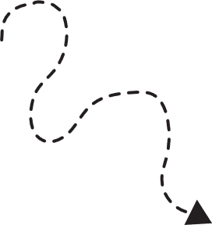


By Harleen Raniyal
Let’s
MEET

Slide 2
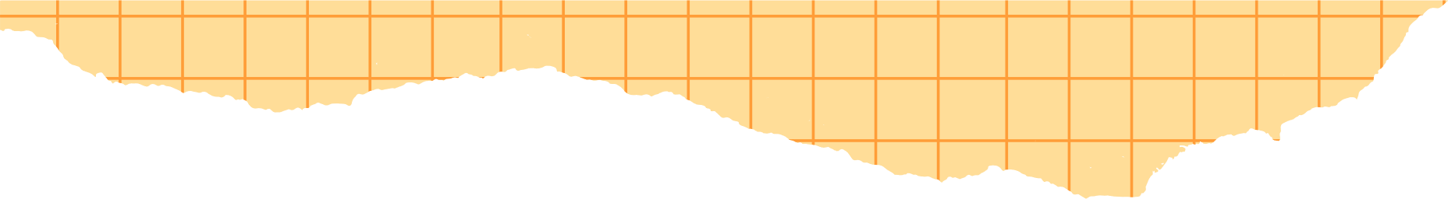



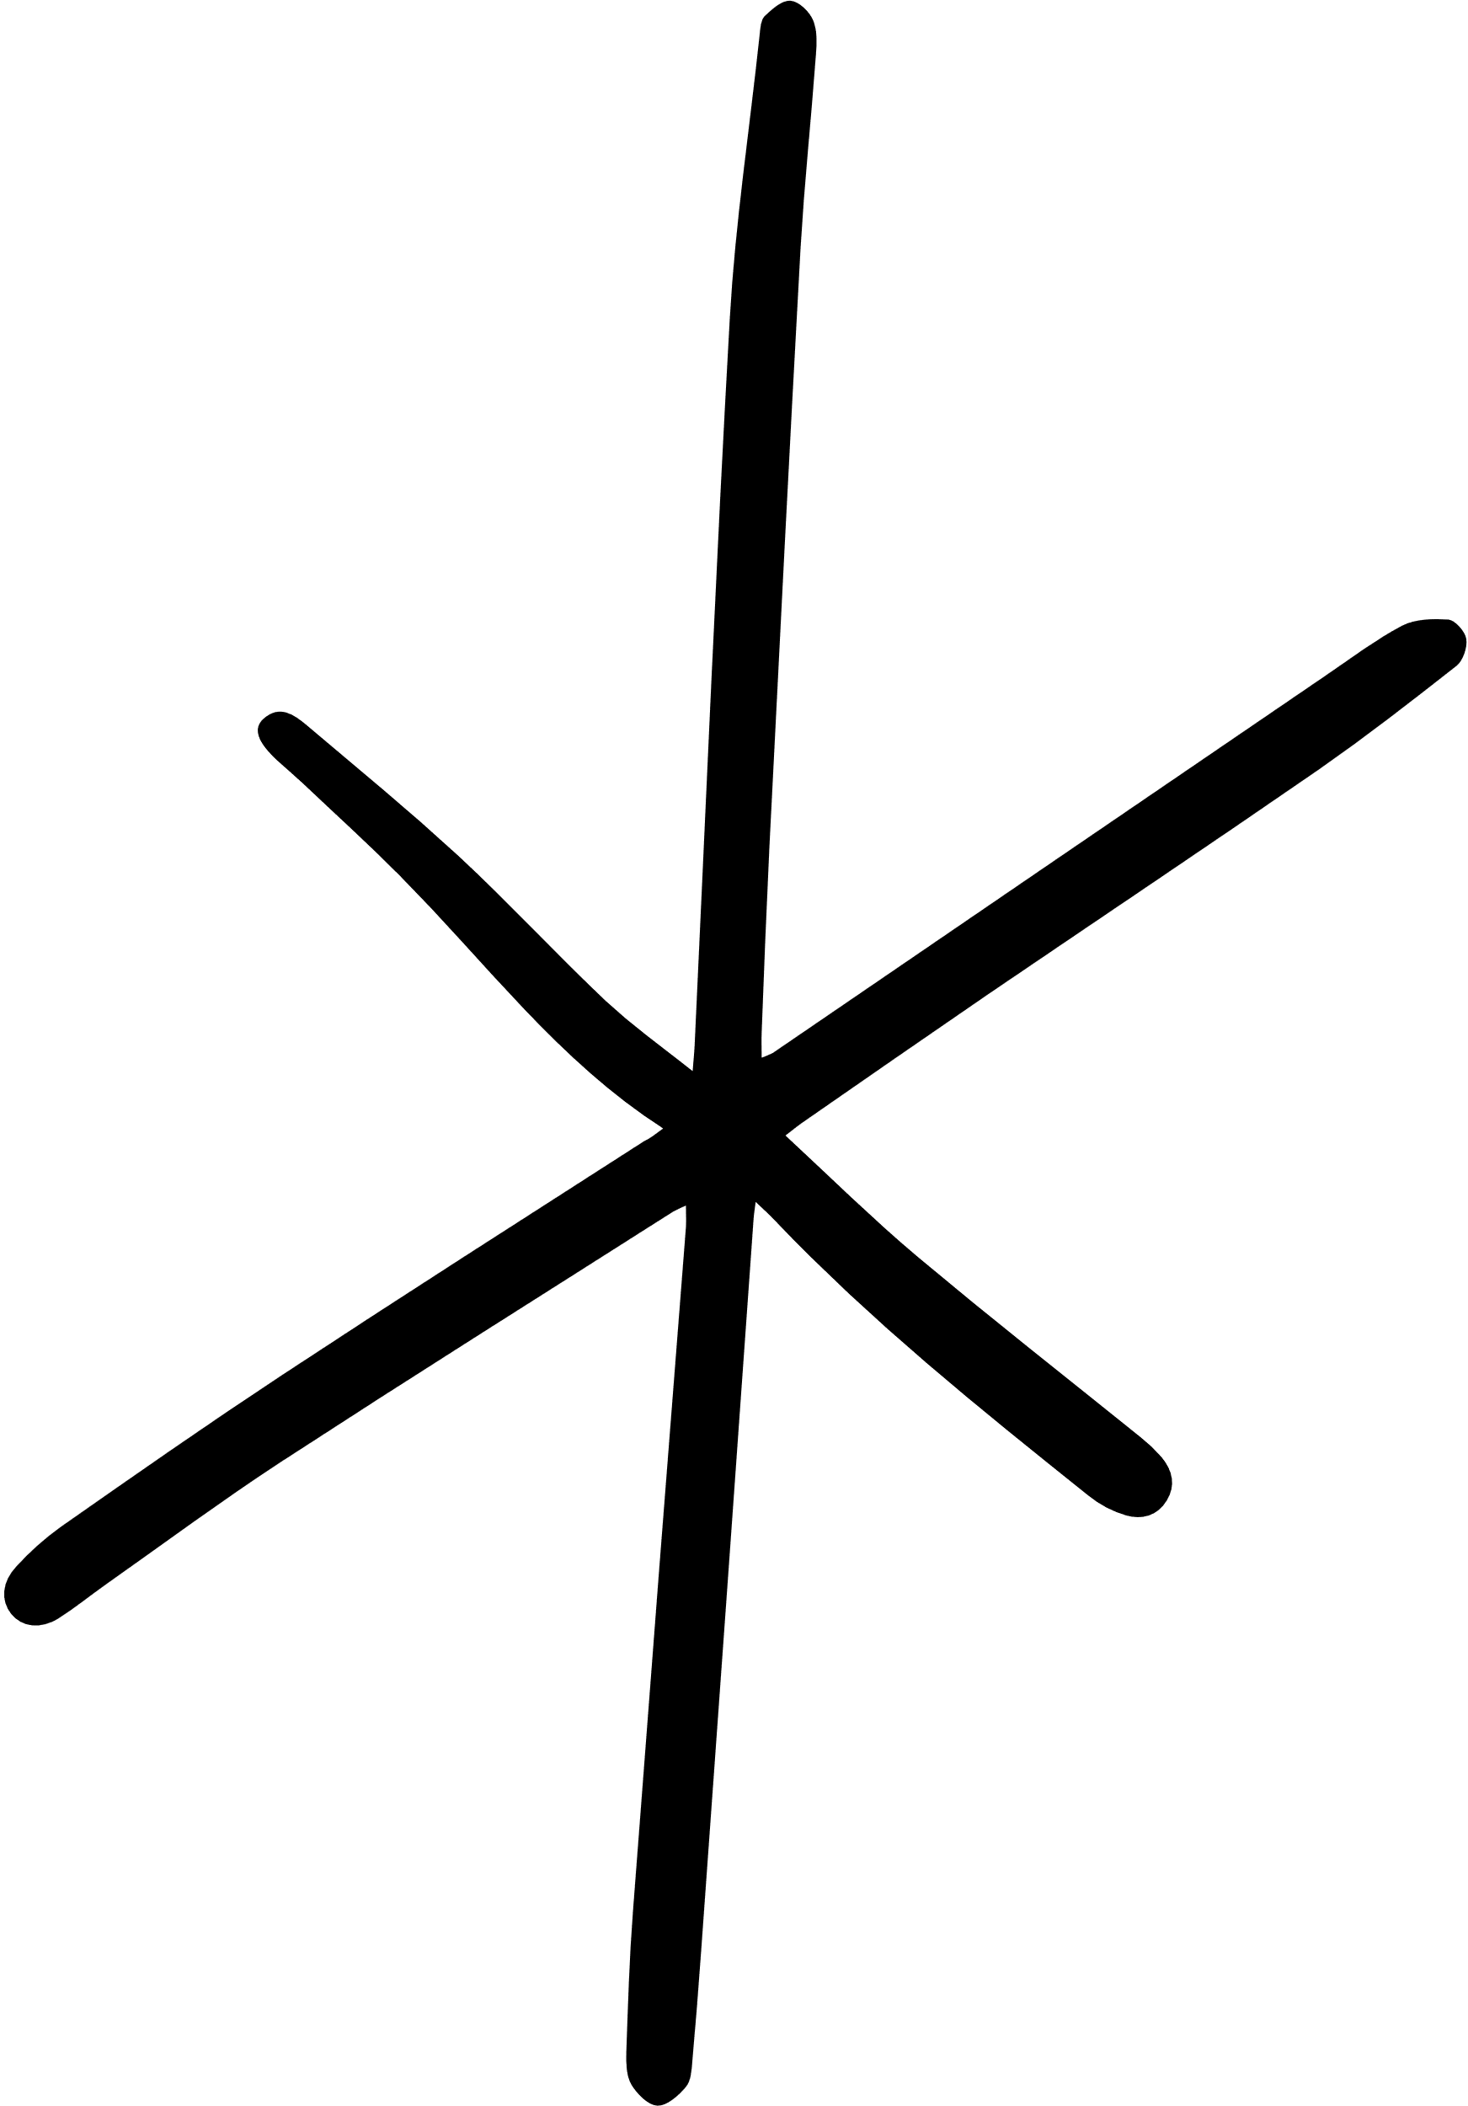
Agenda
Introduction
@Input & @Output
@ViewChild
@ViewChildren
Discussion
Quiz

Slide 3

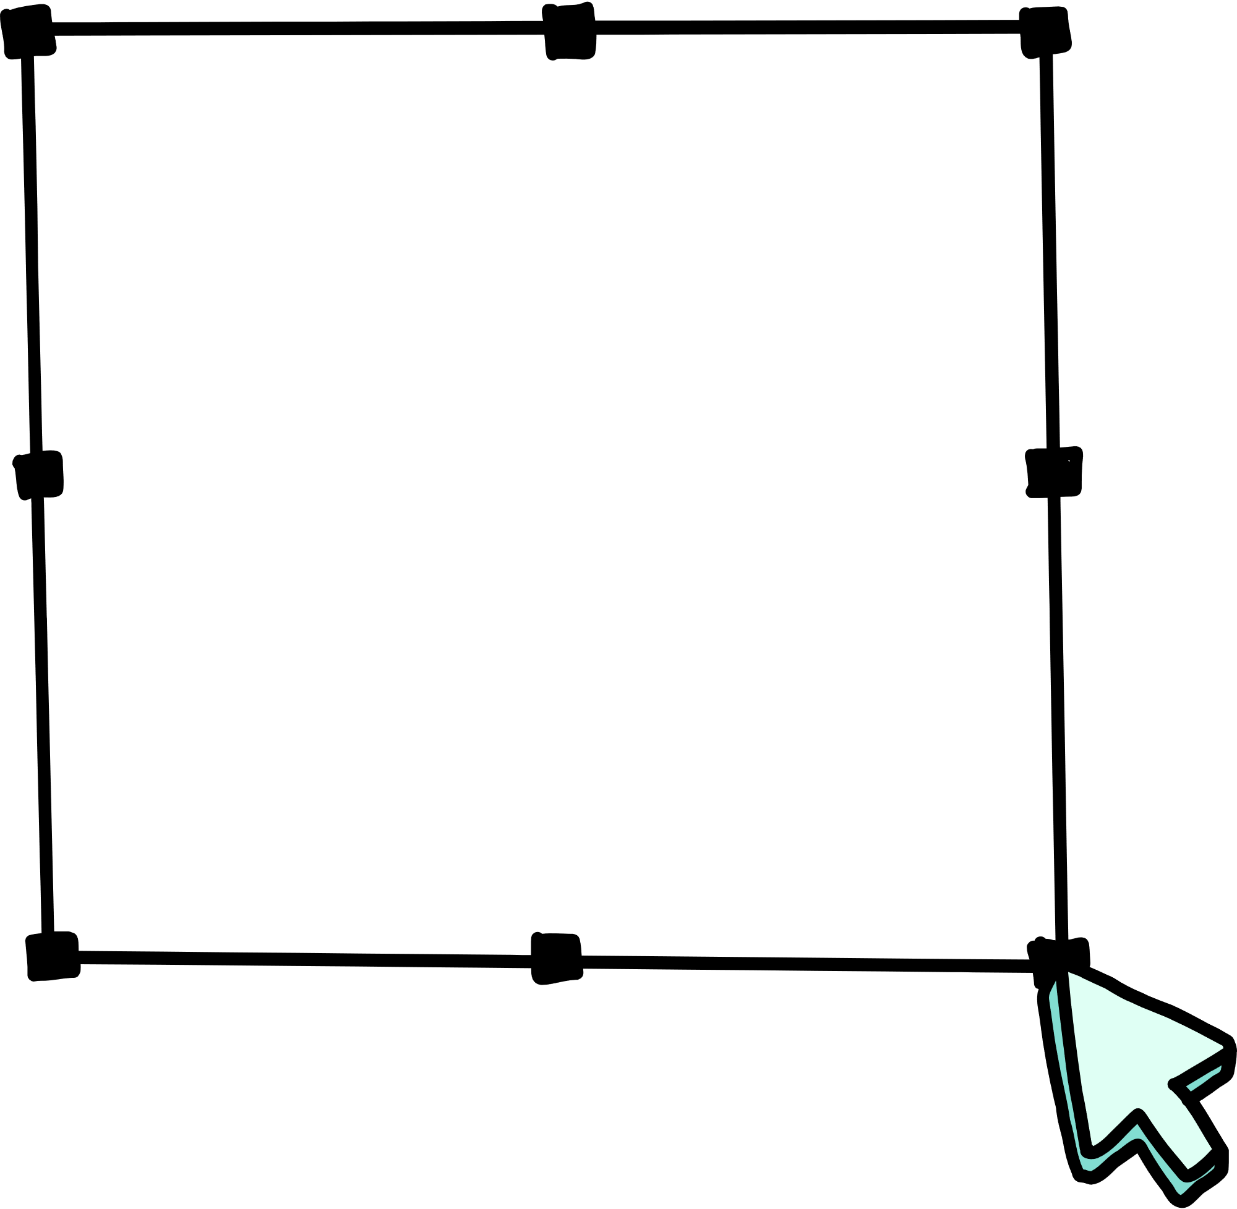

Introduction
Hi there! I’m Angular!

Slide 4
Mind
@ViewChild
MAP
@Input
viewChild is a signal-based query used to retrieve elements from the component's template.
used to pass data from a parent component to a child component.
@ViewChildren
@Output
Use to get the QueryList of elements or directives from the view DOM. Any time a child element is added, removed, or moved, the query list will be updated, and the changes observable of the query list will emit a new value.
used to pass data from a child component to a parent component.

Slide 5




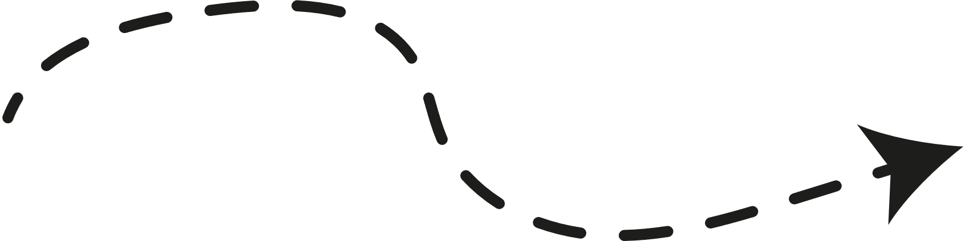
Brainstorming
Brilliant idea!
Awesome idea!
Creative idea!
and Discussion
MAIN RULES
1
There are no rules

Slide 6
THANK
YOU!

